Slide 1

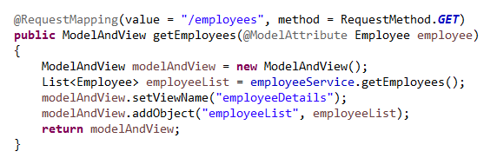
Spring Boot Thymeleaf Example with JDBC
Thymeleaf is a Java template engine for processing HTML, XML, JavaScript, CSS, and text

Slide 2
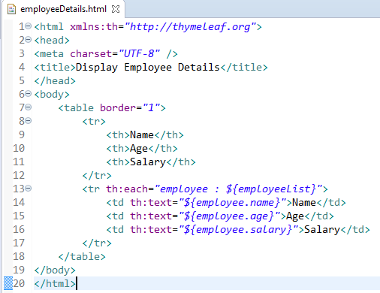
Spring Boot Thymeleaf Example with JDBC
Here we are setting the XML Namespace for Thymeleaf
Thymeleaf th:each will enable us to iterate a collection, we will be iterating each employee object in the employeeList
Using th:text we can access the individual values name, age and Salary.

